Slide 1

Super Market
Billing System

Slide 2

J Component Project Report for the course CSE2004 Database Management System
Submitted to
Dr. RISHIKESHAN C A
Assistant Professor SCOPE VIT Chennai

Slide 3
ACKNOWLEDGEMENT
We wish to express our sincere thanks and deep sense of gratitude to our project guide, Dr. Rishikeshan C A, School of Computer Science and Engineering, for his consistent encouragement and valuable guidance offered to us in a pleasant manner throughout the course of the project work.
We are extremely grateful to Dr. Jagadeesh Kannan, Dean of the School of Computer Science and Engineering, VIT Chennai, for extending the facilities of the school towards our project and for his unstinting support.
We express our thanks to our Head of the Department Dr. Justus S for his support throughout the course of this project.
We also take this opportunity to thank all the faculty of the school for their support and their wisdom imparted to us throughout the course.
We thank our parents, family, and friends for bearing with us throughout the course of our project and for the opportunity they provided us in undergoing this course in such a prestigious institution.

Slide 4




Group Members
Abstract
INDEX
Tools and Platforms
Introduction

Slide 5




PROJECT DESCRIPTION
LIST OF MODULES
INDEX
Tables, Sample code and Snape shorts
Conclusion

Slide 6
KRISHNA PRASAD Y V S PURAMA
20BCE1421
PRANSHU CHOUBEY
20BAI1069
GROUP
MEMBERS
OJASV PARASHA
20BCE1588

Slide 7
The project is a real time, working model of a billing system used at supermarkets.
The GUI in NetBeans as the front end to display information, input data and execute commands regarding the products and purchases.
A Database in MySQL to store, edit and retrieve the information of employees, customer purchases and product details.
This project not only makes the billing process fast, effective and easy, it also helps admin to easily access the employee information, stock details and product purchases which in turn allows continuous stock supply of all products, boosting the sale of the supermarket and the economy.
ABSTRACT

Slide 8



Windows / Mac / Linux
TOOLS
AND
PLATFORMS
NetBeans
MySQL

Slide 9
INTRODUCTION
The project is on Supermarket Billing. Supermarket is the place where customers come to purchase their daily using products and pay for that. So, there is a need to calculate how many products are sold and to generate the bill for the customer. The aim is to automate its existing manual system by the help of computerized equipment and full-fledged computer software, fulfilling the requirements, so that their valuable data/information can be stored for a longer period with easy accessing and manipulation of the same.
For easy and convenient processing, we need to develop software, which work as per us requirements. While preparing this software we got to remember few things i.e., this software must have a friendly environment, in other words it should not be much complicated to handle, it should have option for future modification in the database i.e. in the goods list, new items and workers list. For smooth functioning we had to prepare a database by which we could enter the required data in their respective locations. In this database all the record of daily entry made are stored, so that we can use them in future whenever allotted to their caretaker. Other than that, no one could use this and on entering an illegal password or login name an error message get displayed.

Slide 10
PROJECT DESCRIPTION
The main aim of the project is to manage a billing in easier way. As managing a billing in old tradition is time consuming. In order to make the overall system efficient we want to make this management system.
The main features of the Project are as follows:
On Place Features:
Add, delete, update items, items stock.
Prepare billing info.
Printing the bill.
Barcode scanning.
Payment methods
Cash.
Card.

Slide 11
LIST OF MODULES
1. Login:
This module refers to the login and signup page. Billing person can login upon entering the details like username and password.
2. Menu:
Which gives choice of for selecting either Billing or Updating the items.
3. Billing:
Once the values are entered, the billing process starts. The price of each item is calculated and a total sum is prepared on the computer.
4. Update:
Updating the item stock details, adding new item can easily done. After billing
the stock details will be uploaded.

Slide 12
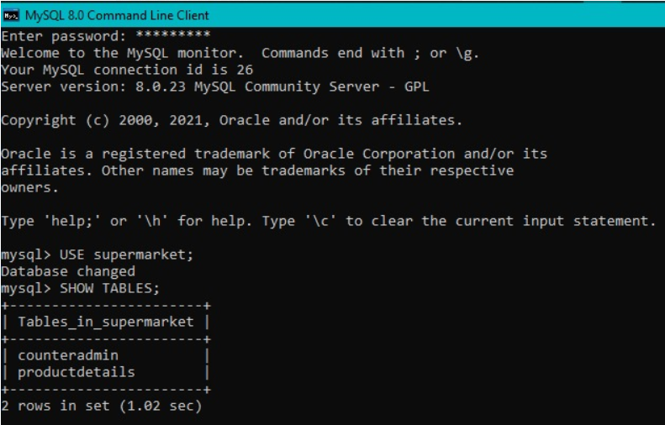
Database Tables

Slide 13
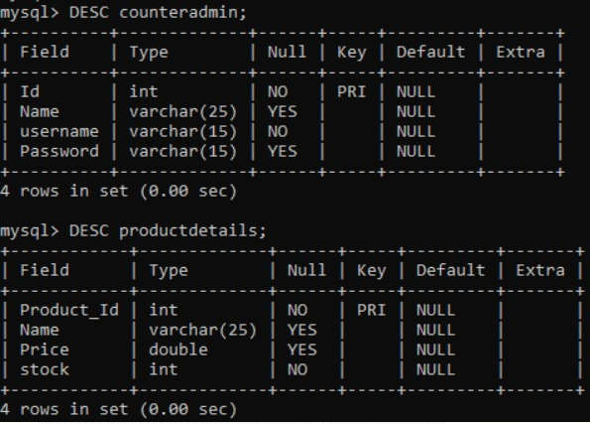
Tables Stucture

Slide 14
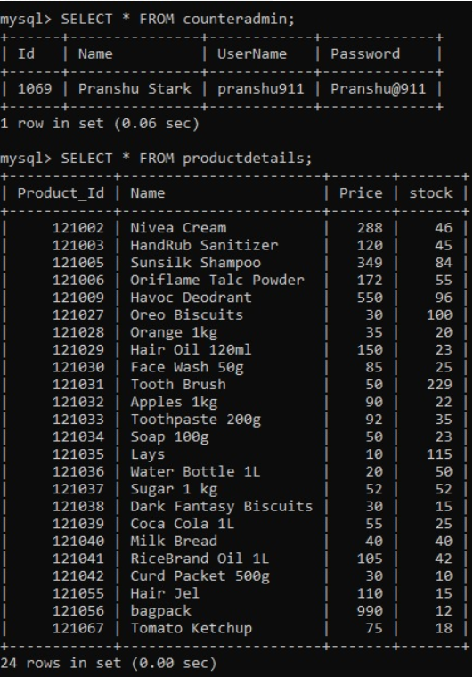
Admin and Product details table

Slide 15
Login Page Code
package supermarket_01;
import java.awt.HeadlessException;
import java.sql.Connection;
import java.sql.DriverManager;
import java.sql.ResultSet;
import java.sql.SQLException;
import java.sql.Statement;
import javax.swing.JOptionPane;
public class LoginPage extends javax.swing.JFrame {
/**
* Creates new form LoginPage
*/
public LoginPage() {
initComponents();
}
public String name="";
private void jButton1ActionPerformed(java.awt.event.ActionEvent evt) {
//Field variables goes here.
// Declaring required variables
String un=unm_feild.getText();
String pw=pwd_feild.getText();
try{
Class.forName("com.mysql.cj.jdbc.Driver");
Connection con =DriverManager.getConnection("jdbc:mysql://localhost:3306/supermarket?zeroDateTimeBehavior=CONVERT_TO_NULL","root","MySQL#911");
Statement st= con.createStatement();
ResultSet rs=st.executeQuery("SELECT `UserName`, `Password`, `Name` FROM `counterAdmin` WHERE UserName= '"+un+"'");
rs.next();
String pwd=rs.getString(2);
if(pw.equals(pwd)){
JOptionPane.showMessageDialog(null,"Log IN Successful");
this.name=rs.getString(3);
new productMenu().setVisible(true);
}
else
JOptionPane.showMessageDialog(null,"Password Is Wrong");
}
catch(HeadlessException | ClassNotFoundException | SQLException e){
JOptionPane.showMessageDialog(null,"UserName Is Incorrect "+e);
}
}
private void jCheckBox1ActionPerformed(java.awt.event.ActionEvent evt) {
if(jCheckBox1.isSelected())
{
pwd_feild.setEchoChar((char)0);
}
else{
pwd_feild.setEchoChar('*');
}
}
public String gName(){
return this.name;
}

Slide 16
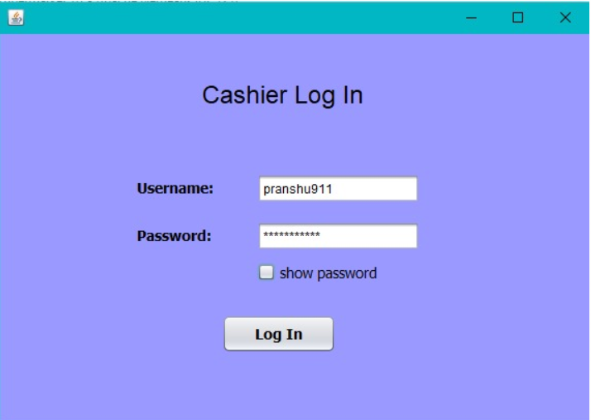
Login Page Panel

Slide 17
Menu Page Code
package supermarket_01;
public class productMenu extends javax.swing.JFrame {
/**
* Creates new form productMenu
*/
public productMenu() {
initComponents();
}
private void jButton1ActionPerformed(java.awt.event.ActionEvent evt) {
// TODO add your handling code here:
new productEntry().setVisible(true);
}
private void jButton2ActionPerformed(java.awt.event.ActionEvent evt) {
// TODO add your handling code here:
new addProduct().setVisible(true);
}

Slide 18
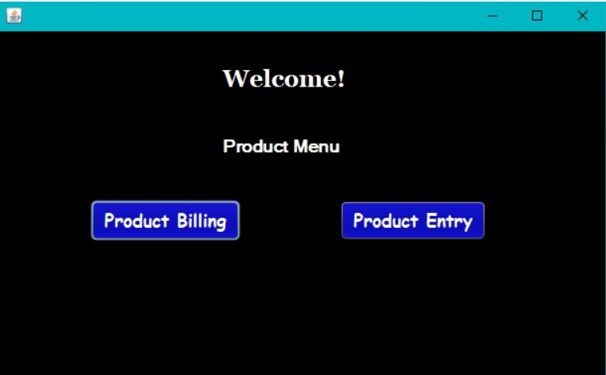
Menu Page Panel

Slide 19
Add/Update Product Page Code
package supermarket_01;
import java.awt.HeadlessException;
import java.sql.Connection;
import java.sql.DriverManager;
import java.sql.ResultSet;
import java.sql.SQLException;
import java.sql.Statement;
import javax.swing.JOptionPane;
public class addProduct extends javax.swing.JFrame {
/**
* Creates new form addProduct
*/
public addProduct() {
initComponents();
}
private void jButton1ActionPerformed(java.awt.event.ActionEvent evt) {
// TODO add your handling code here:
int productId = Integer.parseInt(pid.getText());
String productName = pname.getText();
double price = Double.parseDouble(pprice.getText());
int productStock = Integer.parseInt(pquantity.getText());
try{
Class.forName("com.mysql.cj.jdbc.Driver");
Connection con =DriverManager.getConnection("jdbc:mysql://localhost:3306/supermarket?zeroDateTimeBehavior=CONVERT_TO_NULL","root","MySQL#911");
Statement st= con.createStatement();
st.executeUpdate("INSERT INTO `productDetails`(`Product_Id`, `Name`, `Price`, `stock`) VALUES ('"+productId+"','"+productName+"','"+price+"','"+productStock+"')");
JOptionPane.showMessageDialog(null,"Product Added");
}
catch(HeadlessException | ClassNotFoundException | SQLException e){
JOptionPane.showMessageDialog(null,"Error: "+e);
}
}

Slide 20
Add/Update Product Page Code
private void jButton2ActionPerformed(java.awt.event.ActionEvent evt) {
// TODO add your handling code here:
new productMenu().setVisible(true);
}
private void jToggleButton1ActionPerformed(java.awt.event.ActionEvent evt) {
// TODO add your handling code here:
int uproductId = Integer.parseInt(pid.getText());
int uproductStock = Integer.parseInt(pquantity.getText());
try{
Class.forName("com.mysql.cj.jdbc.Driver");
Connection con =DriverManager.getConnection("jdbc:mysql://localhost:3306/supermarket?zeroDateTimeBehavior=CONVERT_TO_NULL","root","MySQL#911");
Statement st= con.createStatement();
st.executeUpdate("UPDATE productdetails SET stock = '"+uproductStock+"' WHERE Product_Id = '"+uproductId+"' ");
JOptionPane.showMessageDialog(null,"Product Updated");
}
catch(HeadlessException | ClassNotFoundException | SQLException e){
JOptionPane.showMessageDialog(null,"Error: "+e);
}

Slide 21
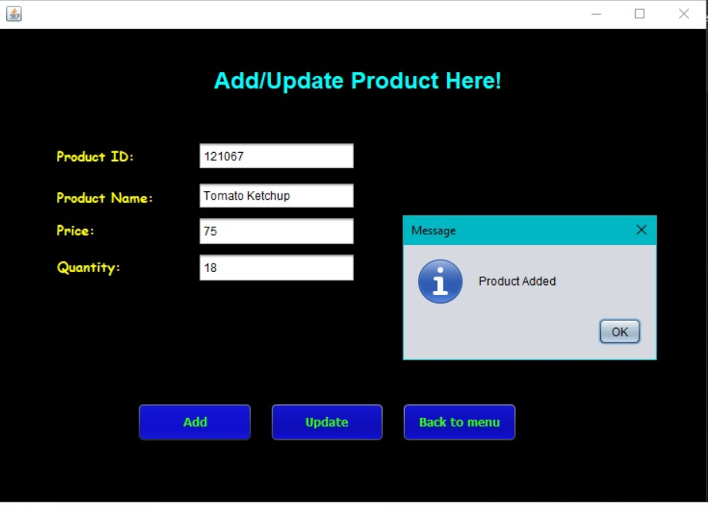
Add/Update Product Panel

Slide 22
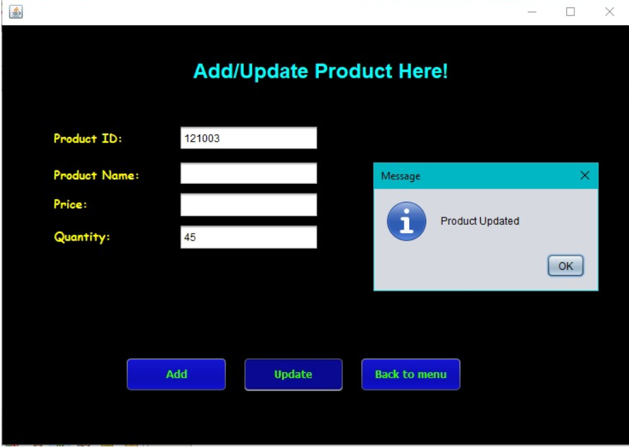
Add/Update Product Panel

Slide 23
Product Billing Page Code
package supermarket_01;
import java.awt.HeadlessException;
import java.sql.Connection;
import java.sql.DriverManager;
import java.sql.ResultSet;
import java.sql.SQLException;
import java.sql.Statement;
import javax.swing.JOptionPane;
import javax.swing.table.DefaultTableModel;
public class productEntry extends javax.swing.JFrame {
/**
* Creates new form productEntry
*/
public productEntry() {
initComponents();
}
double total=0;
private void jButton1ActionPerformed(java.awt.event.ActionEvent evt) {
// TODO add your handling code here:
String productId=pId.getText();
int quantity=Integer.parseInt(p_quantity.getText());
try{
Class.forName("com.mysql.cj.jdbc.Driver");
Connection con =DriverManager.getConnection("jdbc:mysql://localhost:3306/supermarket?zeroDateTimeBehavior=CONVERT_TO_NULL","root","MySQL#911");
Statement st= con.createStatement();

Slide 24
Product Billing Page Code
ResultSet rs=st.executeQuery("SELECT `Name`, `Price` FROM `productDetails` WHERE Product_Id= '"+productId+"'");
rs.next();
double price=rs.getDouble("Price");
String P_name=rs.getString("Name");
double f_price=price*quantity;
total=total+f_price;
//convertind datatypes into String to add in table
String t_price=String.valueOf(f_price);
String t_quantity=String.valueOf(quantity);
//creating array for table data
String tbdata[]={productId,P_name,t_quantity,t_price};
DefaultTableModel tb1M= (DefaultTableModel)table01.getModel();
tb1M.addRow(tbdata);
grand_total.setText(String.valueOf(total));
pId.setText("");
p_quantity.setText("");
}
catch(HeadlessException | ClassNotFoundException | SQLException e){
JOptionPane.showMessageDialog(null,"UnexpectedError: "+e);
}
}
private void jButton2ActionPerformed(java.awt.event.ActionEvent evt) {
// TODO add your handling code here:
this.setVisible(false);
}
private void jButton3ActionPerformed(java.awt.event.ActionEvent evt) {
// TODO add your handling code here:
pId.setText("");
p_quantity.setText("");
grand_total.setText("");
DefaultTableModel tb1M= (DefaultTableModel)table01.getModel();
while(tb1M.getRowCount() > 0)
{
tb1M.removeRow(0);
}
}

Slide 25
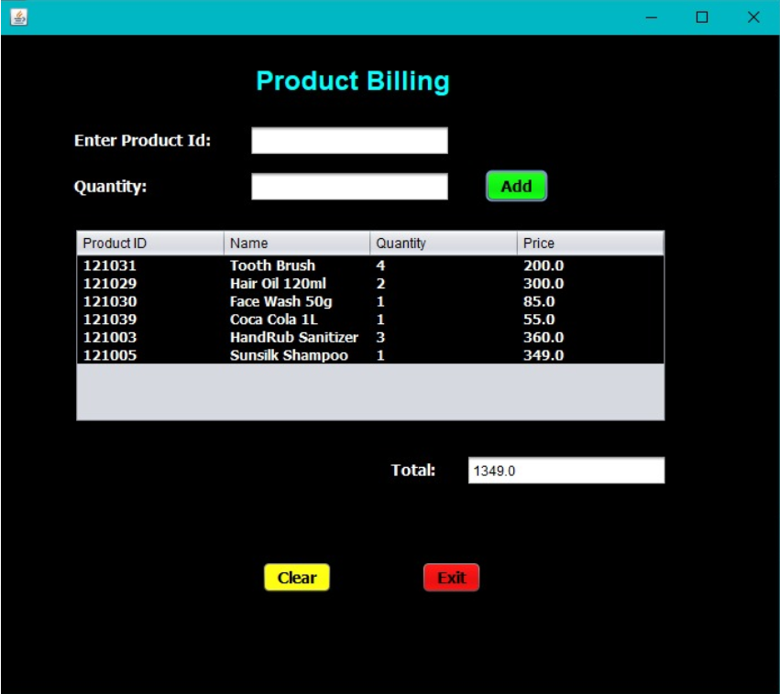
Product Billing Page Panel

Slide 26
CONCLUSION
“Supermarket Billing System’’ software developed for a company has been designed to reduce the time taken to handle the sales activity. It is designed to replace an existing manual record system for reducing time taken for calculations and for storing data. The system uses JAVA NetBeans as front end and MySQL server as a backend for the database. The system is strong to handle daily operations where the database is cleared over certain time. This system will reduce manual work, calculations and will also provide periodic reports anytime. The proposed supermarket management system is very useful for big supermarkets as well as small ones to manage their inventories, staffs, and records of purchases and sales. New features and modules can be easily added into the system, so the project is very flexible and can adapt to, the requirements of the supermarket and its users,

Slide 27

THANK YOU

